Slide 2
OUR THINKING

Slide 3
Insight
Our target audience is 30 and above.
Once you cross the 30-year threshold, certain things lose their appeal.
You are past the “YOLO” stage. You’re past the trying-to-impress-everyone stage.
You are past “being cool”.
You are no longer the target audience of advertising or life,
because life and advertising values ‘youth’ above all else.

Slide 4
Rationale
But who says you must be young?
Or even cool to fit in?
You have matured past the “being cool” stage.
Now, you have grown into yourself.
You know yourself.

Slide 5
Rationale
Now you’re firmly you, secure in the experiences that you’ve accumulated, to make you…you. That’s still cool.

Slide 6
Rationale
Let’s talk about the progression of life.
What was cool then, may not be cool now.
But if you were there then, those things will still be cool to you.

Slide 7
Rationale
Hansa was there.
And Hansa is still here.
Relevant then.
And certainly, relevant now.

Slide 8
Rationale
Not trying to be cool, nor to attract the cool.
It’s mature enough to say,
“if you are still trying to impress everyone,
I’m not your cup of tea.”
Or in this case, your pint of beer.
When everything aligns…

Slide 9
BIG IDEA

Slide 10
THIS PILSENER’S FOR YOU

Slide 11
PRINT

Slide 12
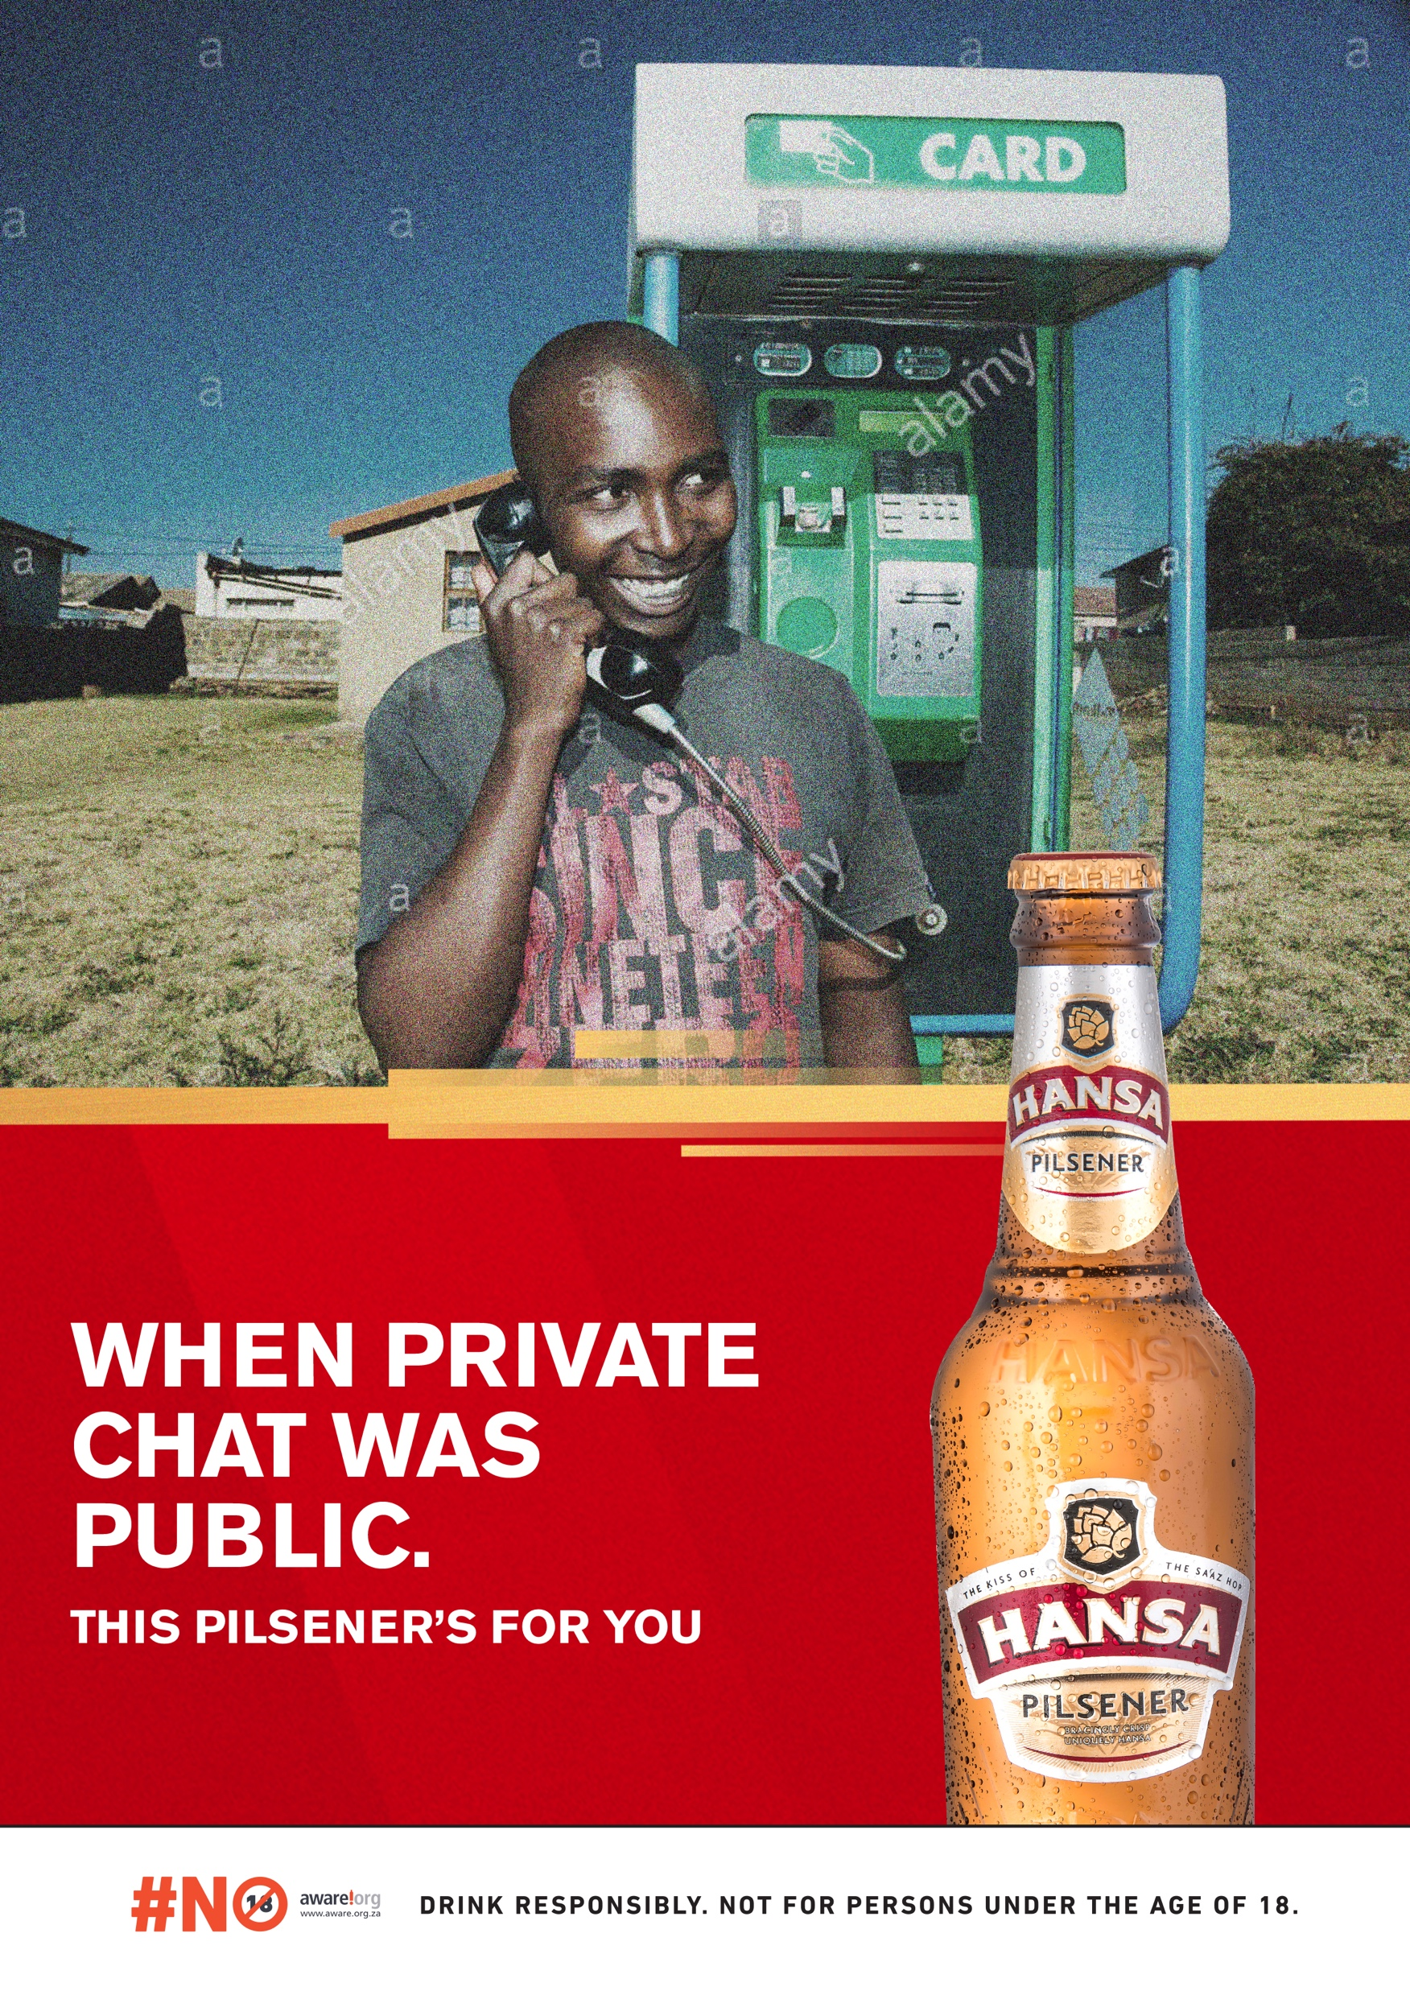
Print

Slide 13

Print

Slide 14
OOH

Slide 15
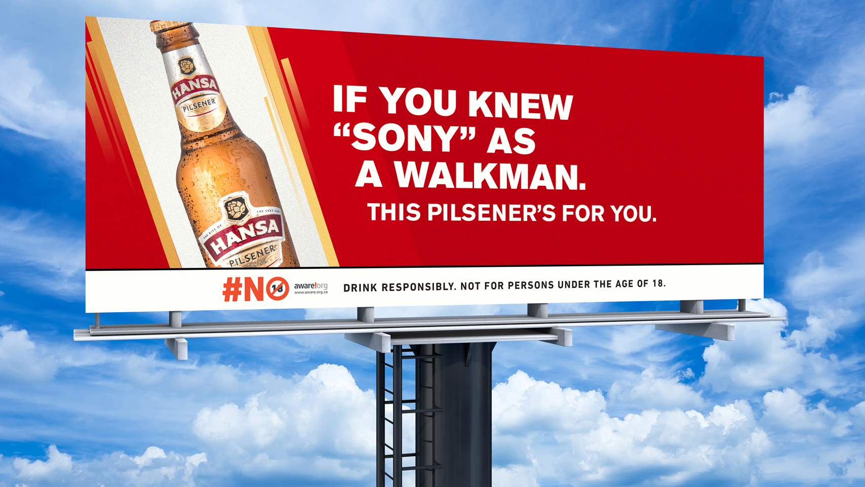
Billboard

Slide 16
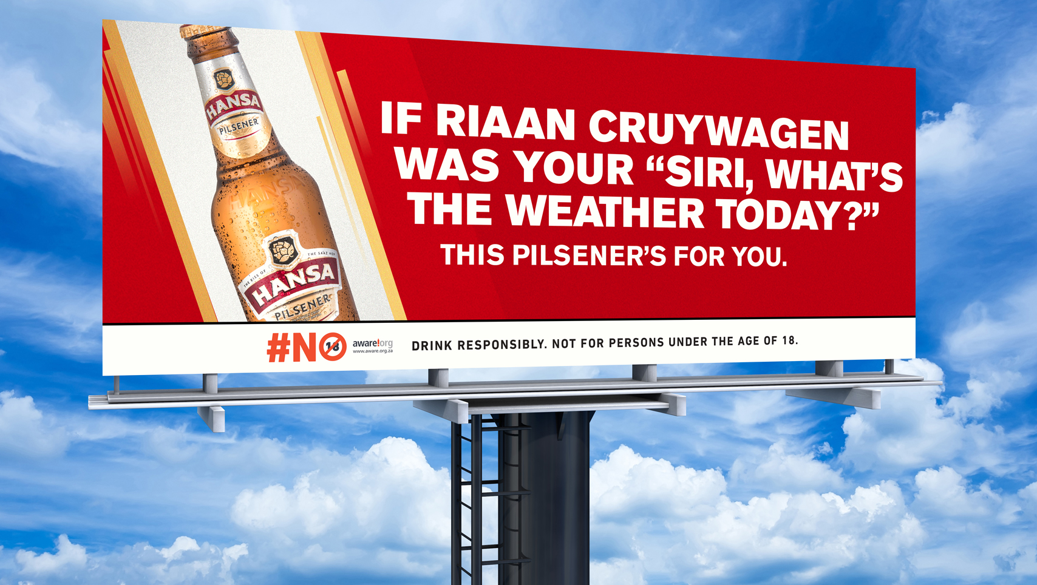
Billboard
Billboard: 6
Pack Shot: “If Riaan Cruywagen was your “Siri what’s the weather today
Campaign Line: “This Pilsener is for you”

Slide 17
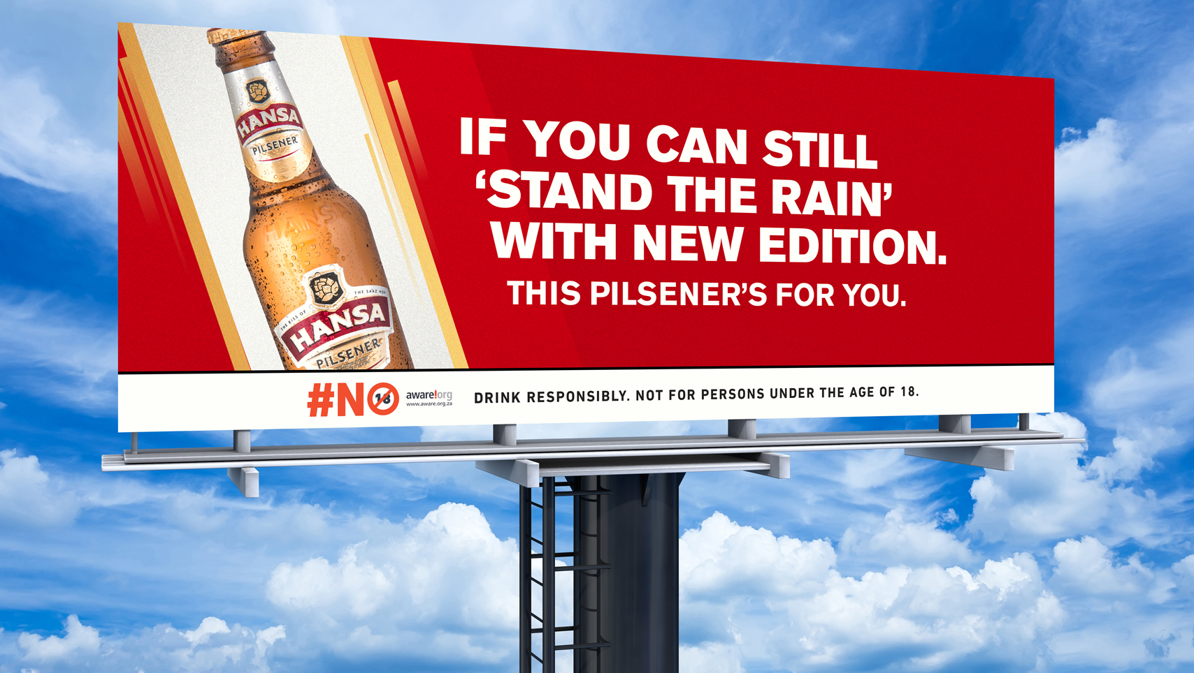
Billboard
Billboard: 4
Pack Shot: “If you can still ‘stand the rain’ with New Edition”
Campaign Line: “This Pilsener is for you”

Slide 18
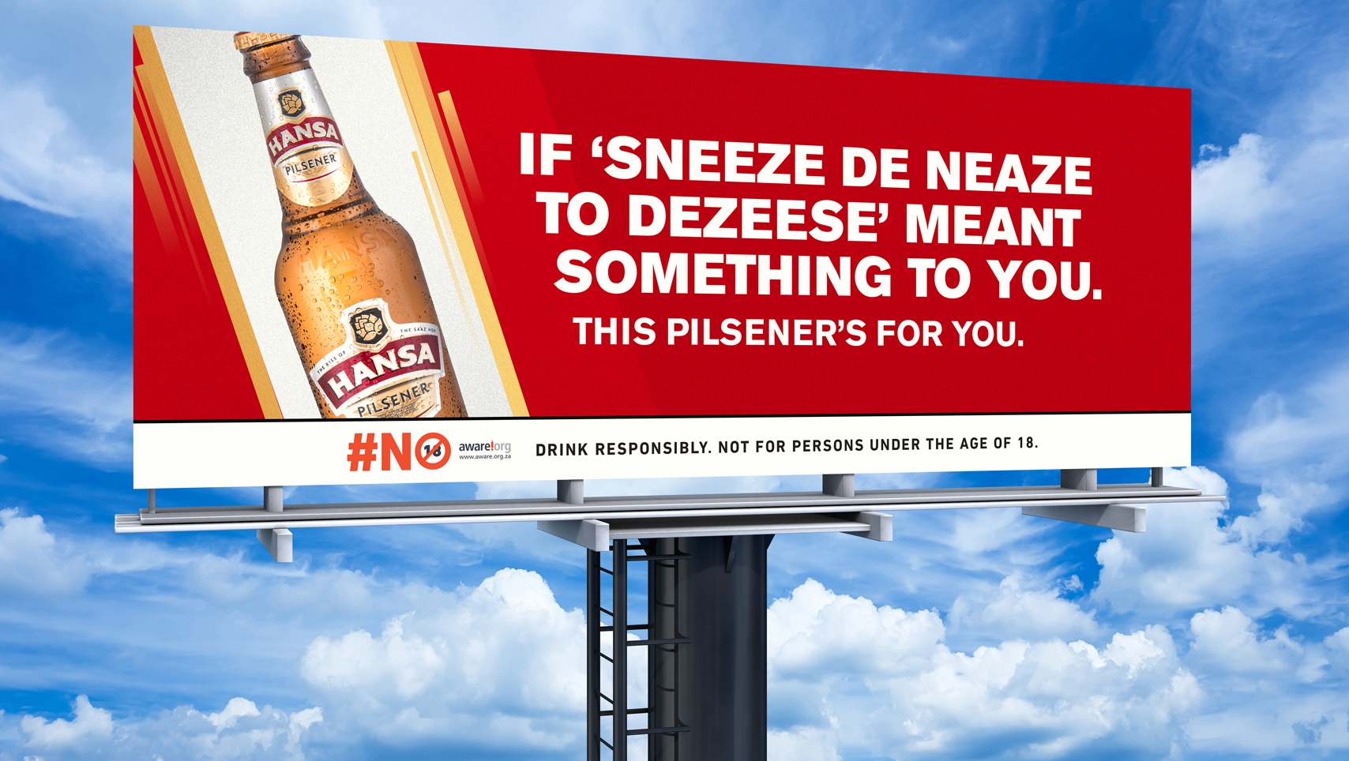
Billboard
Billboard: 1
Pack Shot: “If ‘sneeze de neaze to dezeese’ meant something to you,”
Campaign Line: “This Pilsener is for you”

Slide 19
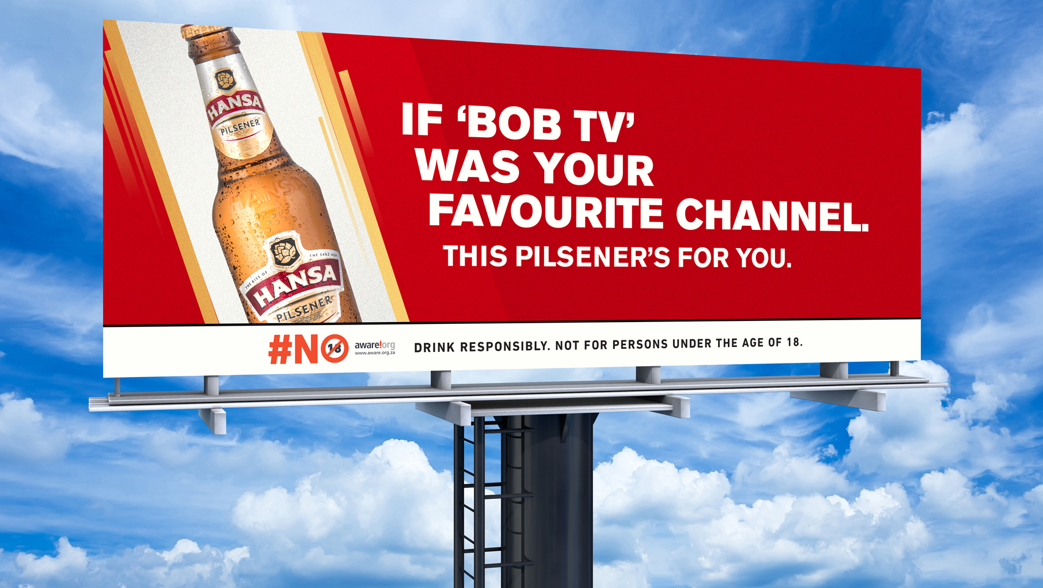
Billboard
Billboard: 2
Pack Shot: “If BOB TV was your favourite channel”
Campaign Line: “This Pilsener is for you”

Slide 20
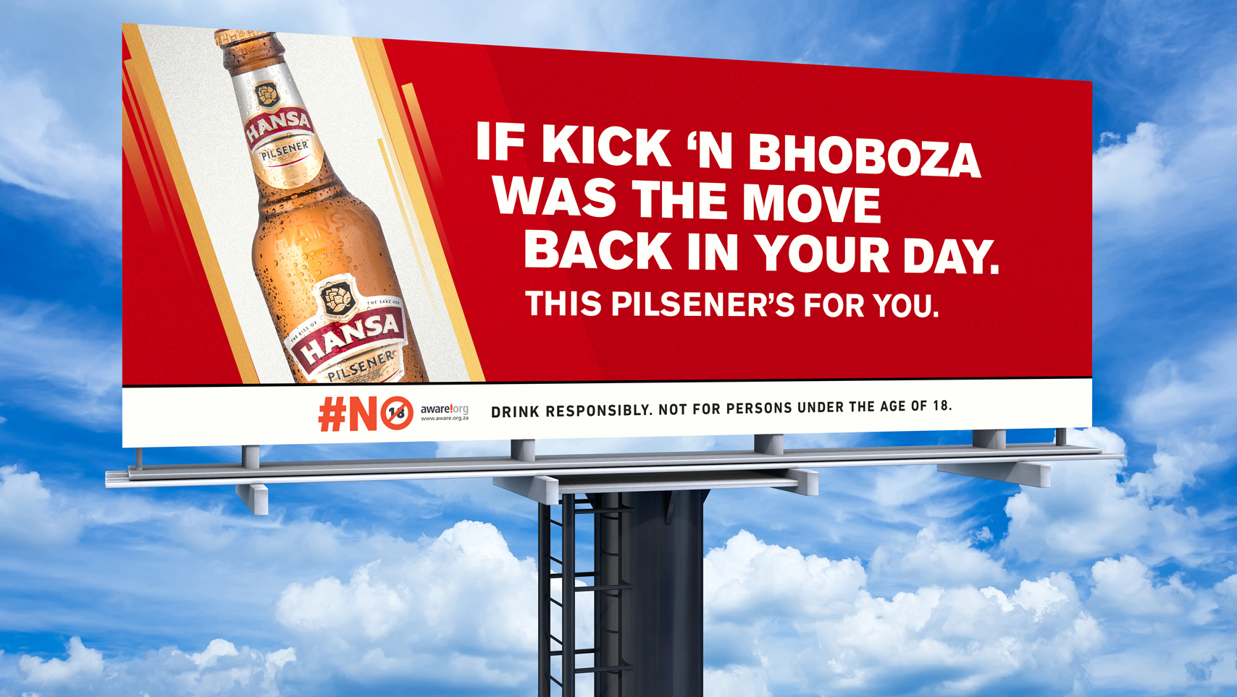
Billboard
Billboard: 3
Pack Shot: “If kick ‘n bhoboza was the move back in your day”
Campaign Line: “This Pilsener is for you”

Slide 21
EARNED MEDIA

Slide 22
CROSSING OVER INTO YOUR 30’S

Slide 23
Earned Media
As you grow older, your health becomes more of a priority.
So, let’s take over a magazine known to promote
Men’s Health to create a first-of-its-kind

Slide 24
Earned Media Idea
Men’s Health issue that’s made for the experienced.
A Men’s Health issue that’s a manual for the under 30s to crossover to the over 30s, the Hansa way.
Where the models don’t have that “six-pack, chiseled bodies” look, but what an actual healthy over 30s look like. Where the topics encourage our drinkers to be authentically themselves and the ‘hot sex tips’ aren’t about changing who they are but working with what they have.
An Authentic Men’s Health Magazine made for Hansa drinkers.

Slide 25


Slide 26
Publisher Mindset
To ensure our Special Edition Men’s Health ‘for the experienced’ issues lives longer than a week, we’ll put a QR code on pack that will lead them to the content hub on the Hansa website to drive data acquisition

Slide 27
DIGITAL CONTENT PIECES

Slide 28
Content Piece
We open on an indoor soccer field as epic background music plays. In slow motion, we see five men who used to be football legends in their kasi, but now have replaced their six-packs with round packs. The camera shows these five guys dressed in their old-school kits, with the name of real soccer legends such as Jomo Sono, Siyabonga Nomvete and John Shoes Moshoeu written on the back of their shirts and wearing their worn-down soccer boots. We cut to their subs, an extra 8 men than they are allowed.
ANN/TITLE: If extra subs are for you, then this Pilsener’s for you.
We end off with a pack-shot and the Hansa Logo build.

Slide 29
Content Piece
We open on an epic background song, our main character, a retired majaivane does a twalatsa, kick and bhoboza and bibo. He’s in the circle of his friends and colleagues who are hyping to keep going even though he’s clearly run out of moves.
ANN/TITLE: If kick and bhoboza’s your move, then this Pilsener’s for you.
We end off with a pack shot and the Hansa Logo build.

Slide 30


If you understand how dope this is,
this campaign is for you.

Slide 31
Thank You!
THANK YOU

